Slide 1
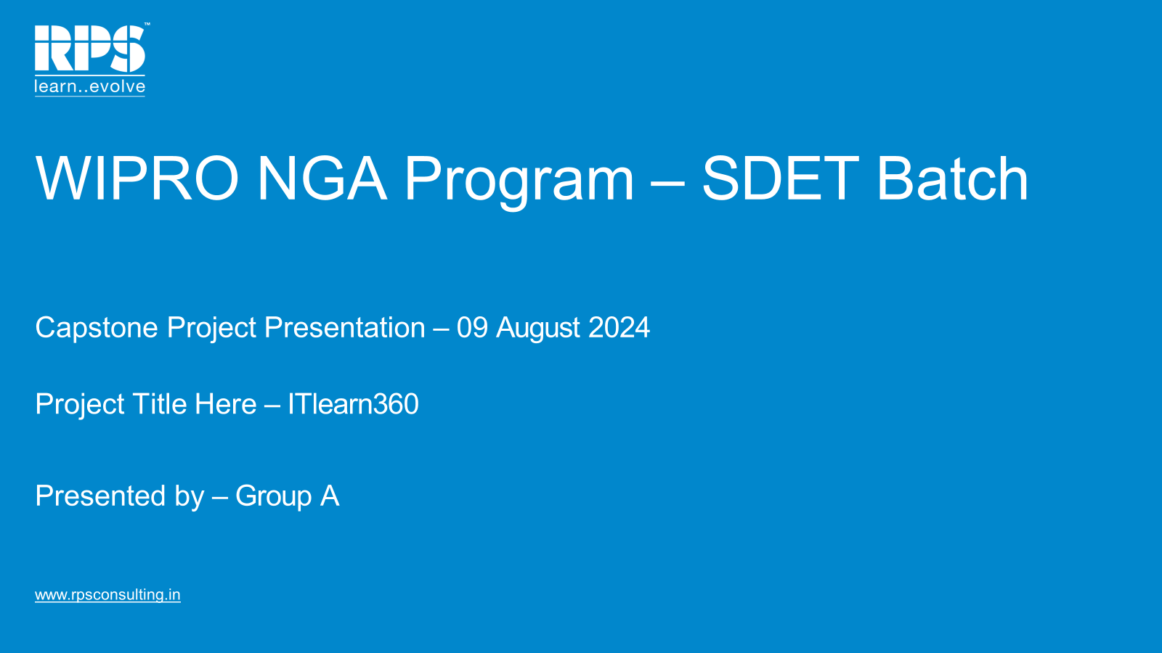

Slide 2


AUTOMATION TESTING ON
ITlearn360
TEAM MEMBERS
Jaya Krishna Kora
Hrutik Gitekar
Ansh Dubey
Soniya P V
Madhurima Mukherjee 6. Shradha Kulkarni
TRAINER
Anand Bhakthavathsala

Slide 3

INTRODUCTION
ITlearn360 is a demonstration website used for educational purposes, particularly in software testing and quality assurance training. It offers a simulated environment for testing various functionalities, such as user login, product browsing, and purchasing processes.
This website is used to create and execute test cases, validate functional requirements, and ensure that all elements of the e-commerce processes work correctly.

Slide 4
OBJECTIVE
The central aim of this capstone project is to construct a durable and streamlined test automation framework for evaluating the
Learning store (https://demo.itlearn360.com/).
The framework integrates Selenium, TestNG, JUnit, BDD-Cucumber, API Testing using Postman and Rest Assured - A Hybrid Framework which uses/generates different approaches to obtain Reports.

Slide 5


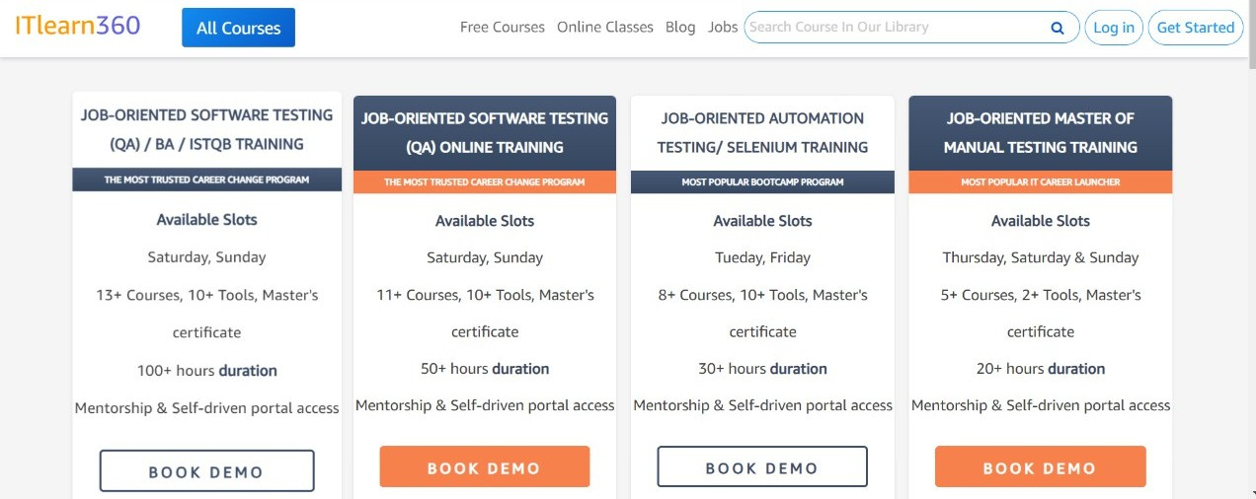

PROBLEM STATEMENT
In Learning store portal, user can login, search, do payment and explore features on dashboard. Users can search for the course and subscribe.
User can update the cart with another course if required and make the payment. Objective is to Automate these workflows using Selenium with TestNG, Page Object Model and getting the data from data sheet and properties file. Thereby, we are testing faster and accurate using automation technique.

Slide 6
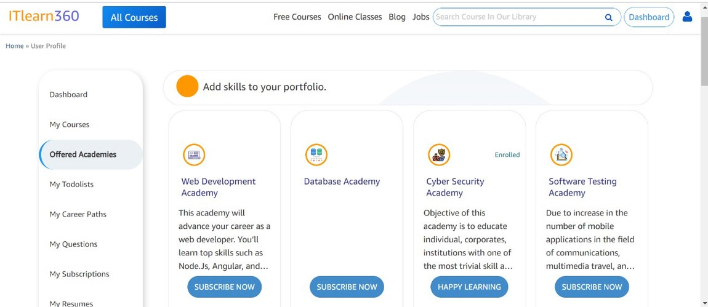
ITlearn360
Online learning platform
SIGNIFICANCE
Practical and Controlled Testing Environment
Demonstrate Automation Efficiency and Accuracy Real - World Challenges and Solutions
Offers a wide range of courses and training programs in various IT fields
Explore and check the details of courses offered
Virtual Purchases

Slide 7



LOGIN
DASHBOARD
SEARCH PAYMENT
DATADRIVEN
TITLE TEST
LOGO TEST
TEST SCENARIOS

Slide 8


TEST FLOW
LOGIN
PLACE ORDER
ENTER CARD DETAILS
DASHBOARD
SUBSCRIBE NOW
PAY NOW
OFFERED ACADEMICS
SELECT COURSE

Slide 9

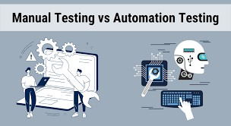
AUTOMATION OVER MANUAL TESTING
Efficiency and Speed Cost-Effectiveness
Consistency and Repeatability Comprehensive Testing Scalability
Performance Testing Reusability and Maintenance Detailed Reporting and Analysis
Continuous Integration and Continuous Deployment (CI/CD)

Slide 10








OUR JOURNEY WITH AUTOMATION

Slide 11
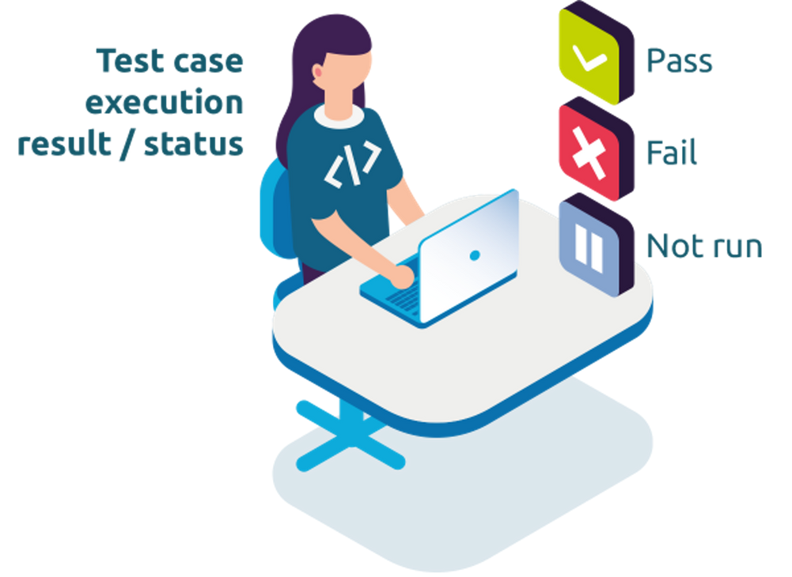

Test Execution
Test Execution is the process of performing test cases to identify bugs, errors, and other potential issues that a software could have.
Test Execution Phases Test Execution Cycle Test Execution State

Slide 12
EXTENT REPORT
Open-source reporting library useful for test automation.
Easily integrated with major testing frameworks like JUnit, TestNG, etc.
Extent Reports offer several advantages when compared to the built-in reports that are generated through JUnit and TestNG such as pie chart representation, test stepwise report generation, adding Screenshots etc.

Slide 13

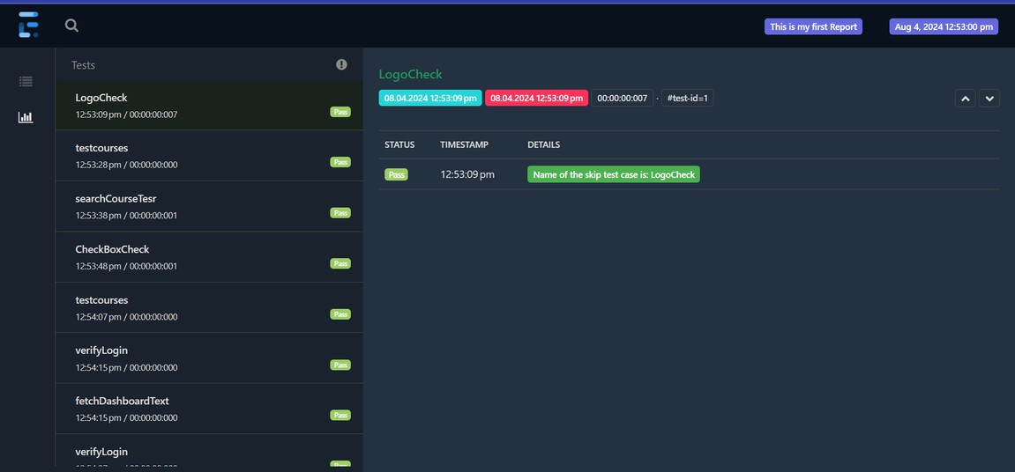
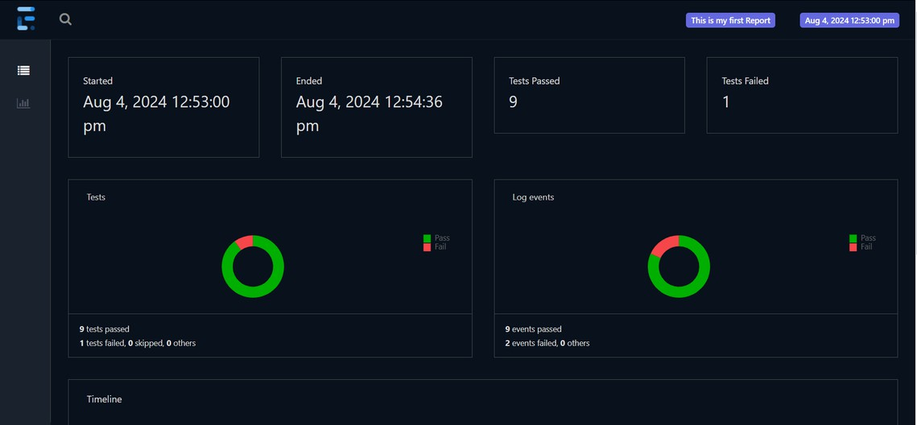
EXTENT REPORT
About the Company 3
Our Mission and Vision 4 5
Our Traction 6
Our Market 7
Our Milestones 8
Our Management Team 9
Our Offered Services 10
Financial Guidance 11
Contact Information 13

Slide 14


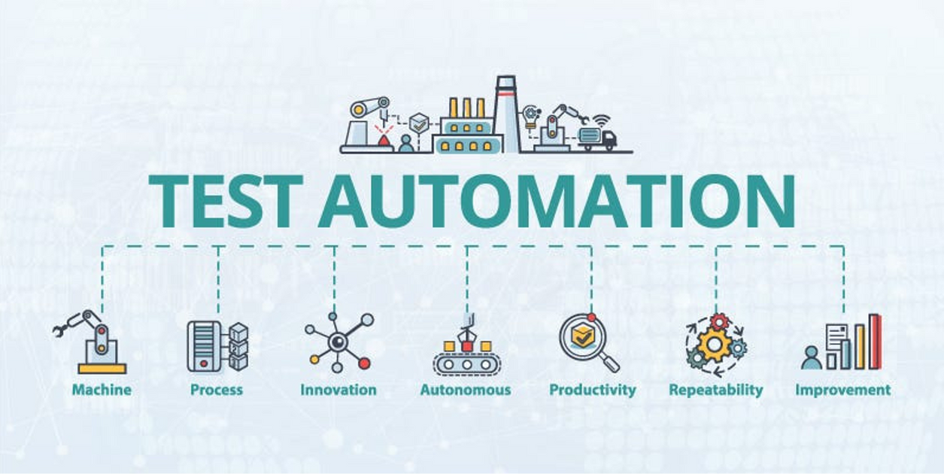
CONCLUSION
Quality Assurance Efficiency Improvement Customer Satisfaction Consistency in Testing Long-Term Cost Savings

Slide 15


THANK YOU

